Slide 1

Technology Partner to the Digital Enterprise
www.jadeglobal.com
Jade Global ©2021

Slide 2

Agenda
1
About Jade Global
2
Enterprise Apps Capability
3
HCM Practice Overview
4
Customer Show Case

Slide 3


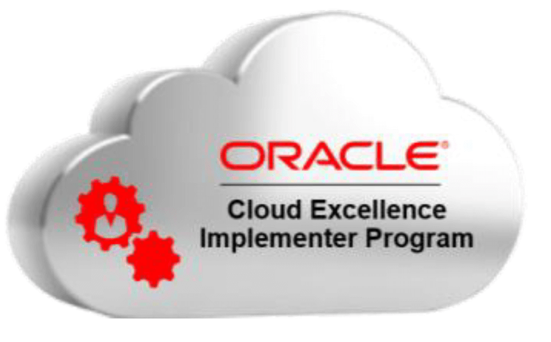




8 Offices
Worldwide
4 Global
Delivery Centers
1500+ Associates
5 Service Lines
Notes:
Industry specializations, Philadelphia

Slide 4







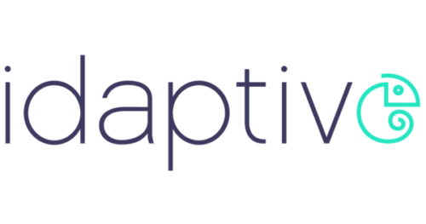




















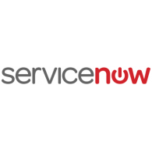



























Clients (Representative list)

Slide 5
Capabilities Overview

Slide 6











Jade Global Enterprise Apps Team
Strong Functional and Technical Professionals Worldwide
Training & Certifications: Cloud Oracle, On Prem Oracle, NetSuite, Workday, PLM
Financials
HCM
70+
80+
Paper Presentations in 2016
Procurement
Cloud CX
40+
8+
Panel Discussions
Projects
Cloud Platform – JCS, ICS, SOA, DBCS, Scripting
100+
95+
Joint Workshops with Partners
Oracle On-Prem Applications
Revenue Management (Oracle RMCS, Zuora, ARM)
250+
25+
Best Speaker
Awards
BI/EPM
PLM
120+
60+
Notes:
EPM 20+
Cloud BI- 50+

Slide 7













HCM Practice Jade Global
Applications
80+ Strong Global Team
    Oracle Cloud HCM
    Workday
    ADP
    Taleo
    Oracle HRM
15
65
Onsite Associates
Offshore Associates
15+ Workday Team ( 8+ Certified)
3
Onsite Associates
12
Offshore Associates
Services
Jade Global HCM Customers
    Implementation
    Assessments/Advisory
    Product Selection
    Upgrades
    Integration
    BI Analytics
    Managed Services

Slide 8


HCM Success Stories (Representative)
Client | Project Details
VMWare | Product Selection Advisory Service for Core HRMS between Oracle and Workday Implemented Oracle HRMS and Benefits Modules
Riverbed | Advisory Services for Assessment of HRMS Application, Jobs Restructuring and Incentive Compensation Implementation of several HR Modules Integrations with ADP and Benefits Providers Implementation support of Workday and Integration of Workday with EBS and Benefit Providers Support of Workday HR
Silicon Storage | Migration from Ceridian HR/Payroll to Oracle Implementation of Core HR, Benefits and Compensation
Uber Technologies | Tier 2 and 3 support for all People Apps Support In integrations to various Benefits provides Support Integrations with external Applicant Tracking System
Infoblox | Enhancements for Workday HR Integration of Workday HR with Oracle ERP Cloud Support of Workday HR
Twitter | Integration of Workday HR with Oracle EBS Cloud Support of Workday HR
Good Technology | Complete assessment of HR systems and processes to create a roadmap for enhancements Implemented new design will provide enhanced visibility to employee records and integrations

Slide 9
Thank You

